Slide 1
DIY site v2

Slide 2
Participants
Kiss-Fodor Zsombor: Group Leader, Main site
Fuglovics Konor: Paint Site
Nagy Szabolcs: Wood Site, Blog
Kispál Marcell: About us Site

Slide 3
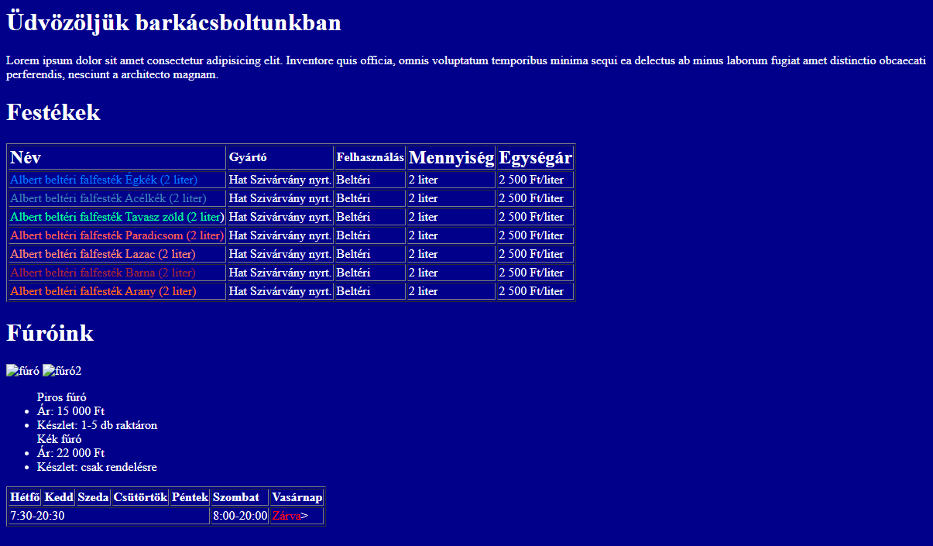
The old webSite and the Problems about it
Outdated Design
Missing informations
Hardly Readable
Not Responsive

Slide 4
Customer expectations
The page must comply with the HTML5 Standard
Be responsive and have modern design
The infromation comprehensive presentation, and Display
User Friendly Navigation.

Slide 5
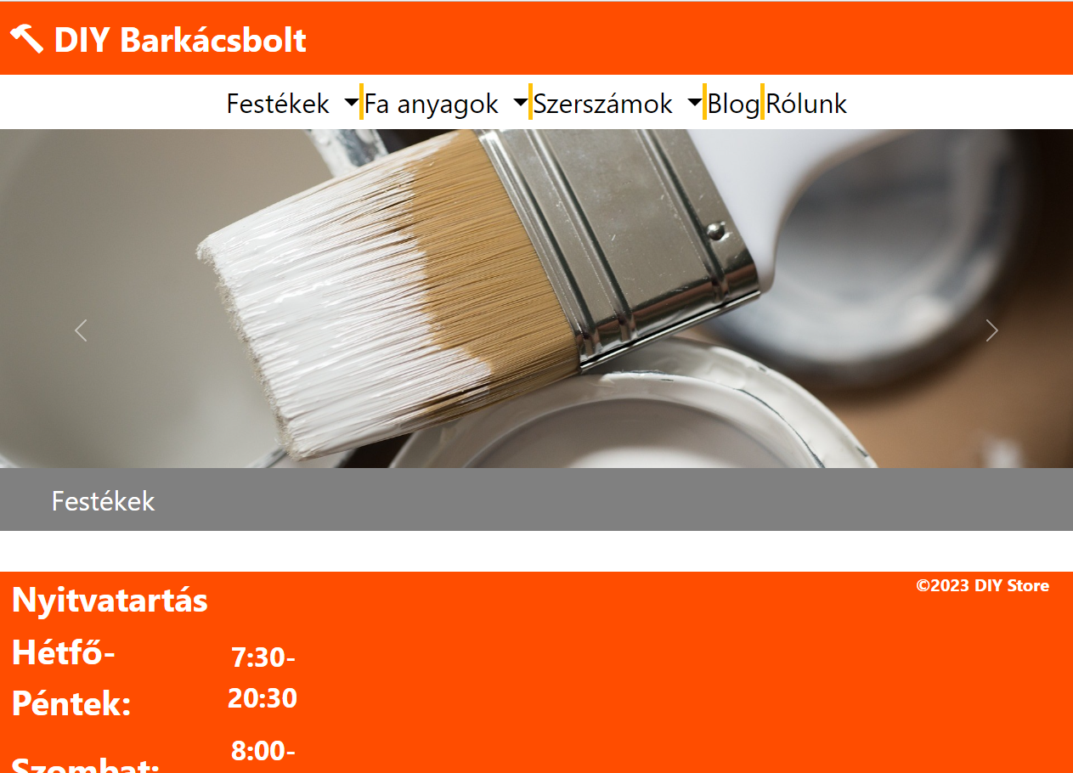
Old VS New website
Régi weboldal
Új weboldal

Slide 6
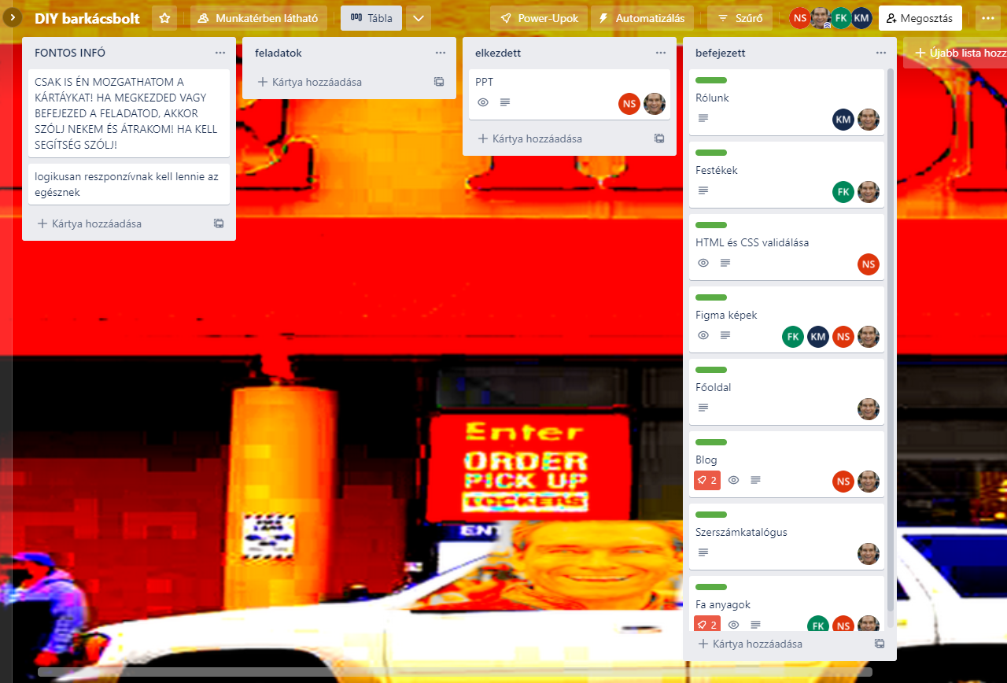
Trello Workprocesses

Slide 7
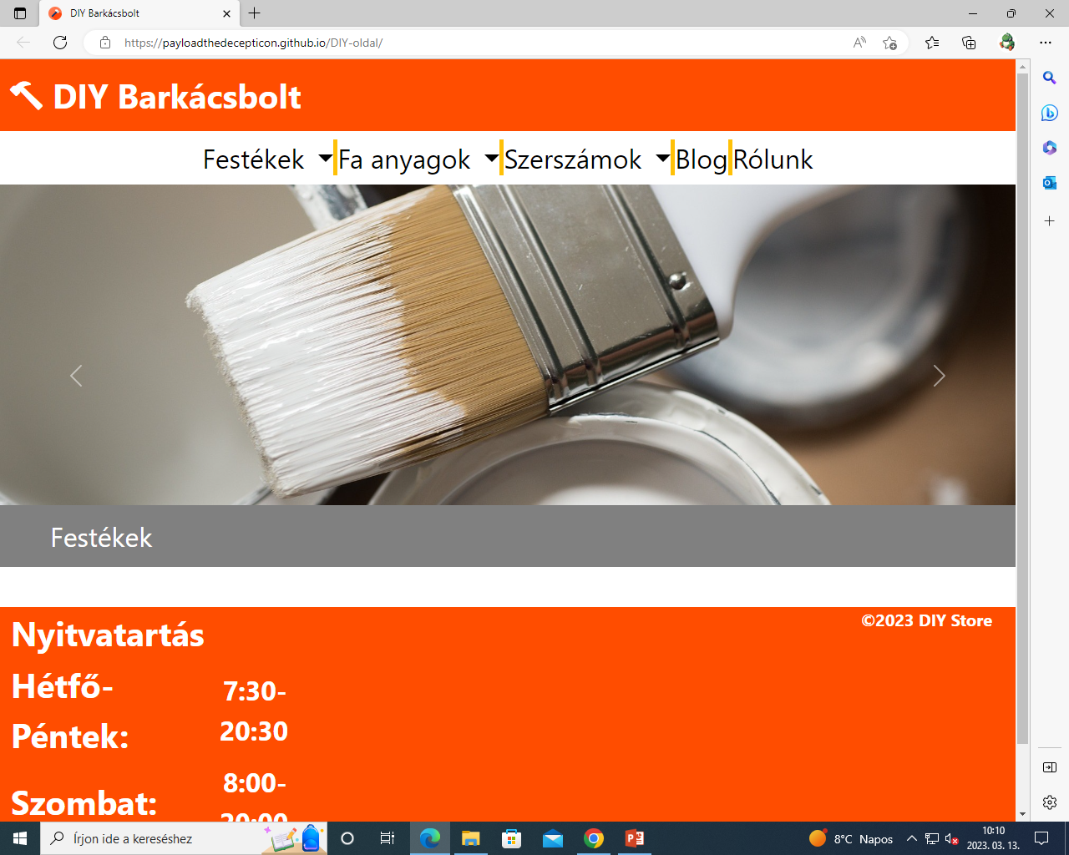
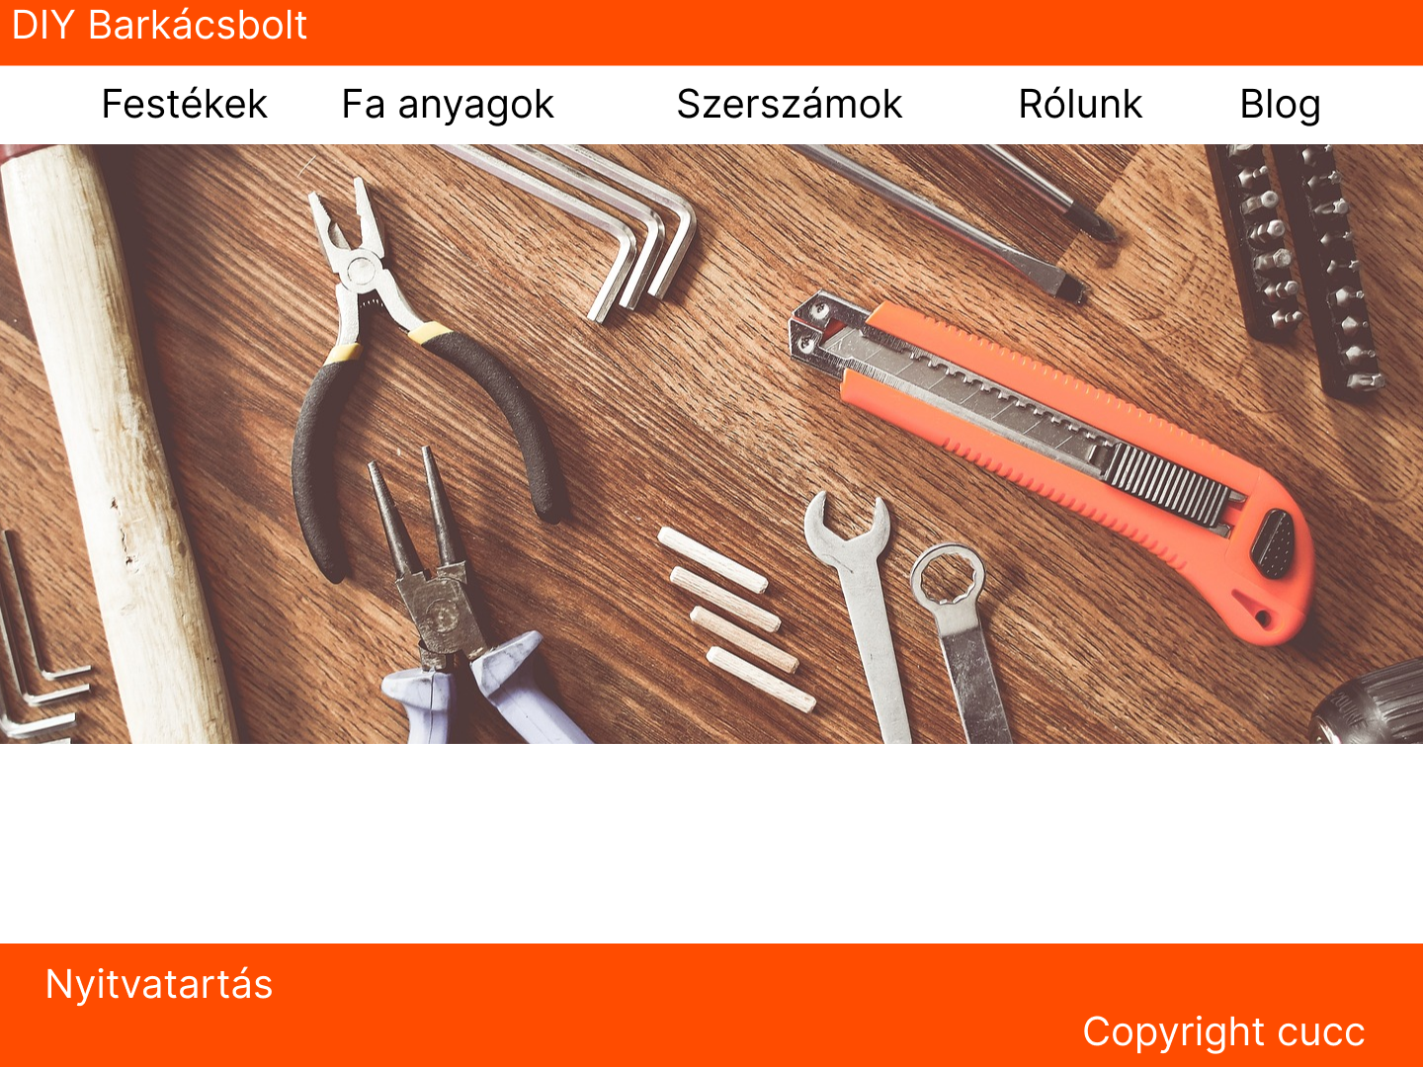
Figma vs Finished main site

Slide 8
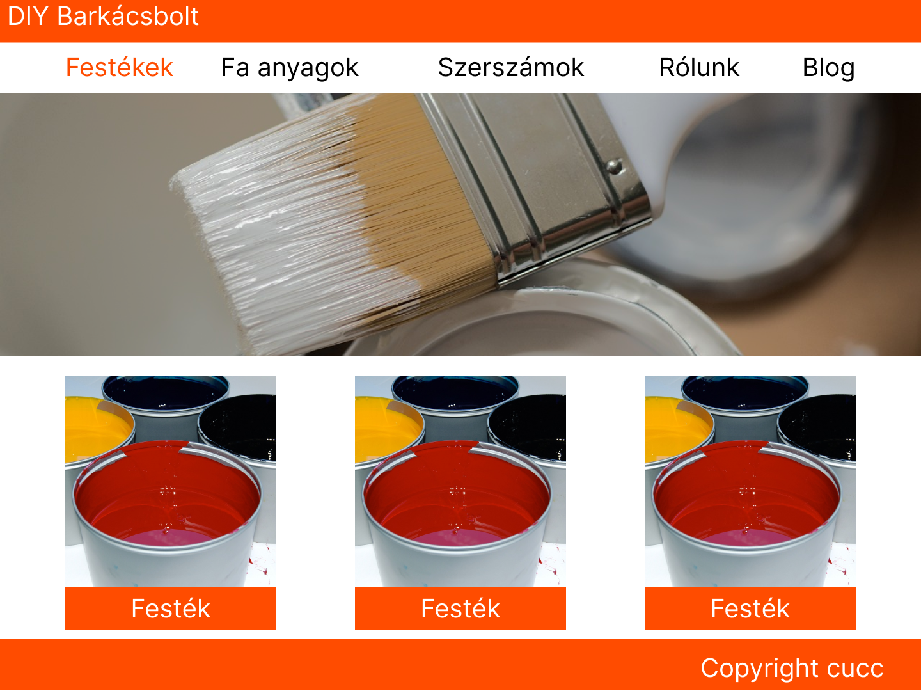
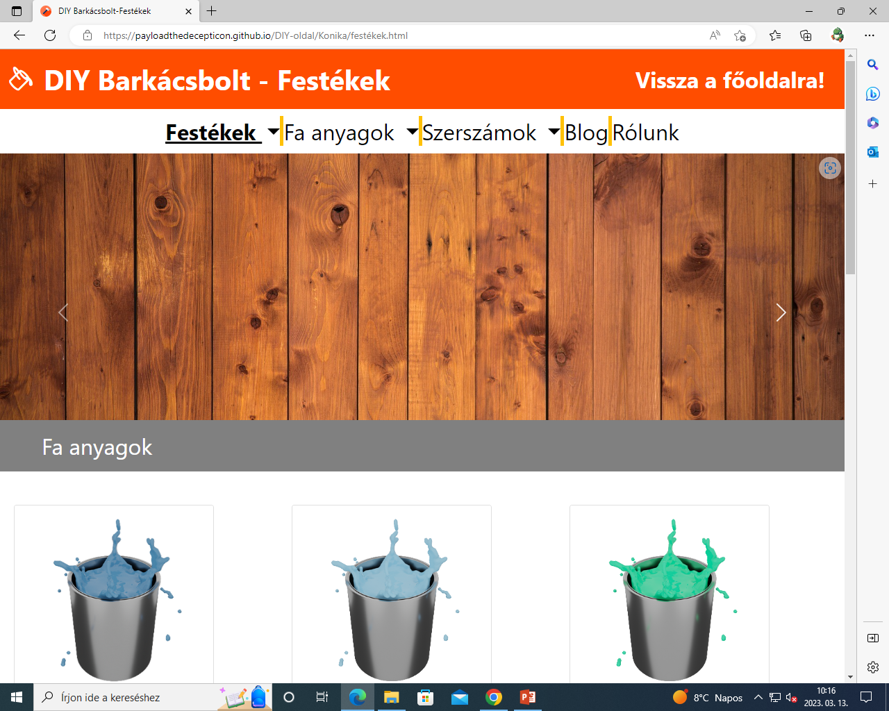
Figma vs finished paint site

Slide 9
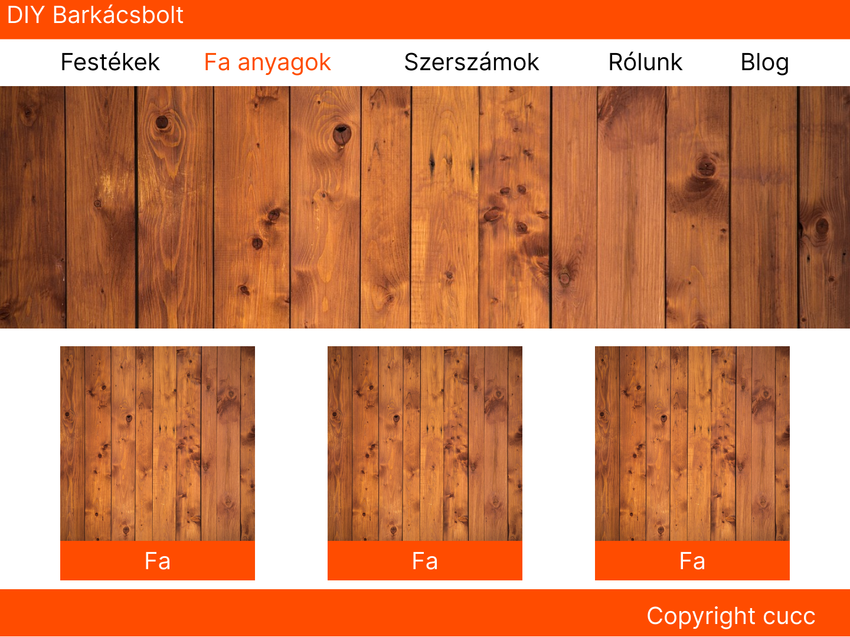
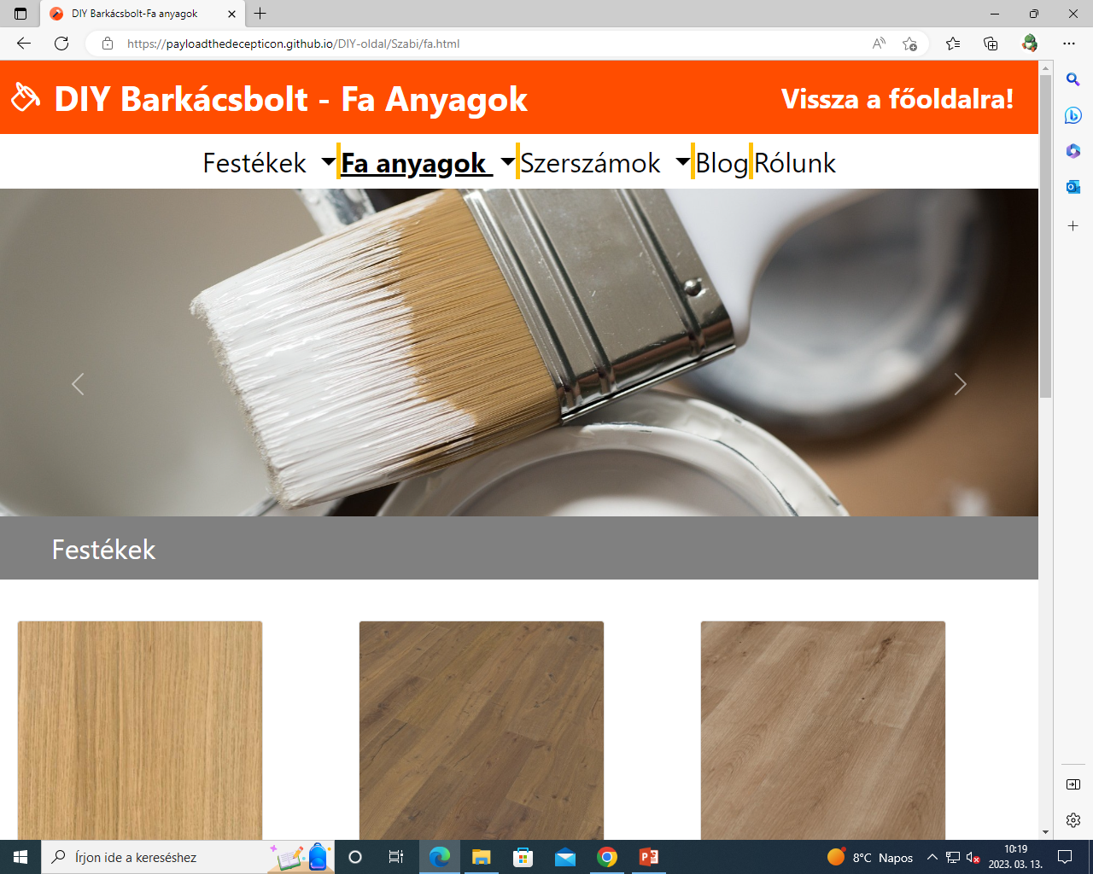
Figma vs finished Wood site

Slide 10
Github pages: https://payloadthedecepticon.github.io/DIY-oldal/
Pár szó a csapat tagjaitól:
„Hajnal 3 kor commitolni az igazi” – Nagy Szabolcs
„Nincs commit, nincs probléma” – Kispál Marcell
„Festéket renderelni nagy hiba” – Kiss-Fodor Zsombor
„Kódolás könnyű mint az 1x1” – Fuglovics Konor

